Slide 1
Finding the cost of algorithm
UNIT 1

Slide 2
TO ANALYZE ALGORITHMS
First, we start to count the number of significant operations in a particular solution to assess its efficiency.
Then, we will express the efficiency of algorithms using growth functions.
Each operation in an algorithm (or a program) has a cost.
Each operation takes a certain of time.
count = count + 1; ➔Take a certain amount of time, but it is constant
A sequence of operations:
count = count + 1;
sum = sum + count;
Cost: c1 Cost: c2
Total Cost: c1 + c2

Slide 3
THE EXECUTION TIME OF ALGORITHMS
Example: Simple If-Statement
Cost
Times
1
1
if (n < 0)
absval = -n else
absval =
c1 c2
n; c3
1
Total Cost <= c1 + max(c2,c3)

Slide 4
LOOP
 |  |  |  |  |  |  | Cost | Times
i = | 1; |  |  |  |  |  | c1 | 1
sum | = | 0; |  |  |  |  | c2 | 1
whil | e | (i | <= | n) |  | { | c3 | n+1
i = |  | i | + | 1; |  |  | c4 | n
sum |  | = | su | m | + | i; | c5 | n
}
Total Cost = c1 + c2 + (n+1)*c3 + n*c4 + n*c5
The time required for this algorithm is proportional to n

Slide 5
NESTED LOOP
 |  |  |  |  |  | Cost | Times
i=1; |  |  |  |  |  | c1 | 1
sum | = | 0; |  |  |  | c2 | 1
whil | e | (i | <= | n) | { | c3 | n+1
 | j=1; while (j sum = | <= su | n) m | + | { | i; | c4 c5 c6 | n n*(n+1) n*n
 | j = j | + | 1; |  |  |  | c7 | n*n
 | }
 | i = i +1; |  |  |  |  |  | c8 | n
}
Total Cost = c1 + c2 + (n+1)*c3 + n*c4 + n*(n+1)*c5+n*n*c6+n*n*c7+n*c8
➔ The time required for this algorithm is proportional
to n²

Slide 6
GENERAL RULES FOR ESTIMATION
Loops: The running time of a loop is at most the
running time of the statements inside of that loop times the number of iterations.
Nested Loops: Running time of a nested loop
containing a statement in the inner most loop is the running time of statement multiplied by the product of the sized of all loops.
Consecutive Statements: Just add the running times of those consecutive statements.
If/Else: Never more than the running time of the test plus the larger of running times of S1 and S2.
24

Slide 7
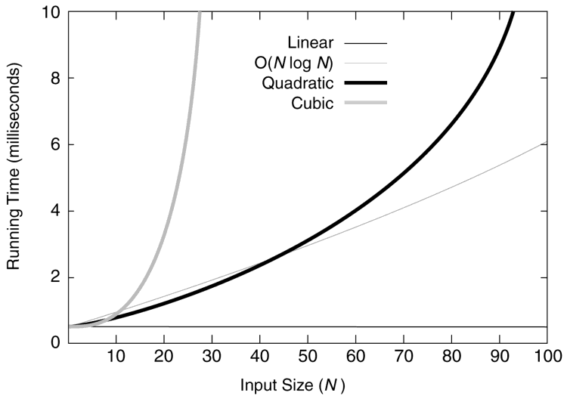
Running times for small inputs
Figure 1.1
28

Slide 8
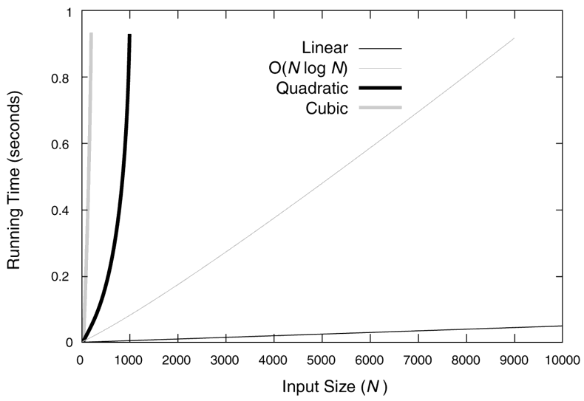
Running times for moderate inputs
Figure 1.2
29

Slide 9
SPACE COMPLEXITY
#include <stdio.h> Void main()
{
int a, b, c, sum;
printf(“Enter three numbers:”);
scanf(“%d%d%d”,&a,&b,&c); sum=a+b+c;
printf(“Sum=%d”,sum);
}
No instance
characteristics
Space required by a,b,c and sum is independent of instance
S(P)=Cp+ Sp
S(P)=4+0
S(P)=4

Slide 10
Some of basic and most common time complexities such as
Constant Time Complexity O(1) : constant running time
Linear Time Complexity O(n) : linear running time
Logarithmic Time Complexity O(log n) : logarithmic running time
Log-Linear Time Complexity O(n log n) : log-­linear running time
Polynomial Time Complexity O(n^c) : polynomial running time (c is a constant)
Exponential Time Complexity O(c^n) : exponential running time (c is a constant being raised to a power based on size of input)
24

Slide 11
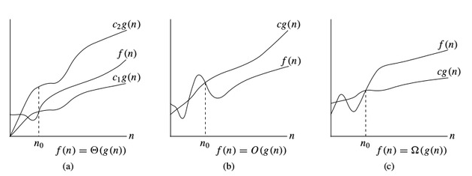
Asymptotic Notation - Revision
24

